Slide 1
OBJECT ORIENTED
ANALYSIS AND DESIGN
Ch - 10
Inheritance and Polymorphism
A study material for the students of GLS University

Slide 2
Generalization
Generalization is the process of extracting common characteristics from two or more classes and combining them into a general (parent) class.
The specific class (child) has all features of the general class but adds some more details.
It shows a “is-a” relationship.
Example: Tree (general) → Oak Tree (specific)

Slide 3
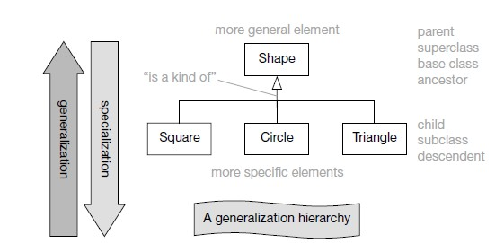
Class generalization
Specialization (Top-Down):
Start with a broad/general concept (e.g., Shape).
Add details step by step (Circle, Square, Triangle).
Generalization (Bottom-Up):
Start with many specific classes (e.g., Car, Bus, Truck).
Notice common features (all are Vehicles) and create a general superclass.

Slide 4
Class Inheritance
When you model generalization in UML, you are also modeling inheritance in programming.
What gets inherited?
Attributes (variables/data members)
Operations (methods)
Associations (relationships with other classes)
Constraints (rules)
What subclasses can do?
Reuse all features from the superclass.
Add new attributes/methods of their own.
Override superclass methods to provide their own implementation.

Slide 5
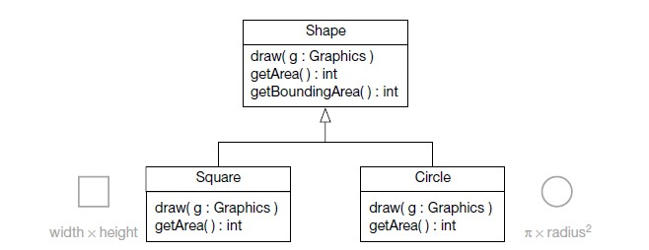
Overriding
Subclasses override inherited operations by providing a new operation with the same signature.
To override a superclass operation, a subclass must provide an operation with exactly the same signature as the superclass operation it wishes to override.

Slide 6
Abstract Classes and
Abstract Operations
No implementation
Abstract classes have one or more abstract operations, and they can’t be instantiated
In UML, writing the operation name in italics
Incomplete as operations don’t have an implementation
can’t instantiate classes and they are therefore known as abstract classes
You write the class name in italics to show that it is abstract

Slide 7
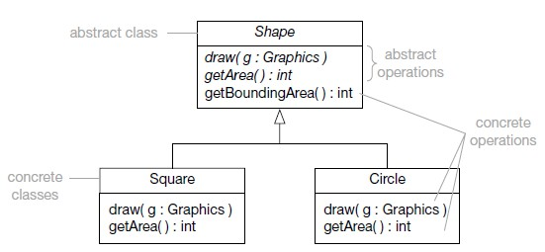
Example

Slide 8
Advantages of using abstract classes and operations
You can define a set of abstract operations in the abstract superclass that must be implemented by all subclasses. You can think of this as defining a “contract” that all concrete subclasses must implement.
You can write code to manipulate Shapes and then substitute Circle, Square and other Shape subclasses as appropriate. According to the substitutability principle, code written to manipulate Shapes should also work for all Shape subclasses.

Slide 9
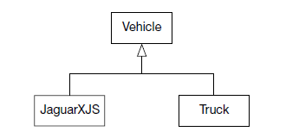
Level of Abstraction
At same level in a generalization hierarchy - should be at the same level of abstraction
Levels of abstraction from the most general at the top to the most specific at the bottom
Maintain a uniform level of abstraction at each level of the generalization hierarchy
Example:
Clearly this is a lower level of abstraction than Truck. You can fix the model quite easily by introducing a Car superclass between JaguarXJS and Vehicle

Slide 10
Multiple Inheritance
Multiple Inheritance - A class can have more than one direct superclass
UML allows a class to have more than one direct class
The subclass inherits from all of its direct superclasses

Slide 11
Polymorphism
Polymorphism means “many forms”
A polymorphic operation is one that has many implementations
You have already seen two polymorphic operations in the
Shape example.
The abstract operations draw( ) and getArea( ) in the Shape class have two different implementations – an implementation in the Square class and a different implementation in the Circle class. The operations have “many forms” and are therefore polymorphic

Slide 12
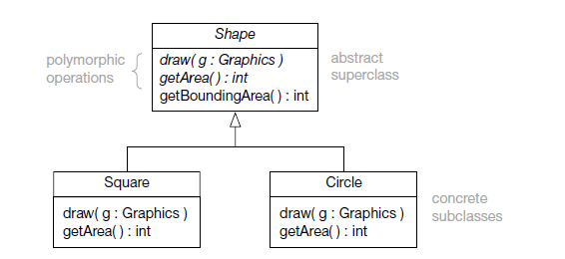
Example

Slide 13
Polymorphism – objects of different classes have operations with the same signature but different implementations
If you send objects of the Square class the message draw( ) they will draw a square, and if you send objects of the Circle class the same message they will draw a circle

Slide 14
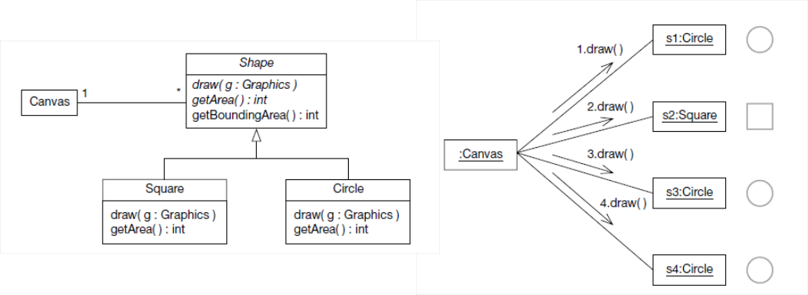
Polymorphism Example

Slide 15
Advanced Generalization
Two advanced aspect of generalization
Generalization sets
Powertypes
Generalization Sets
A generalization set is a collection of related generalizations that apply to the same parent class.

Slide 16
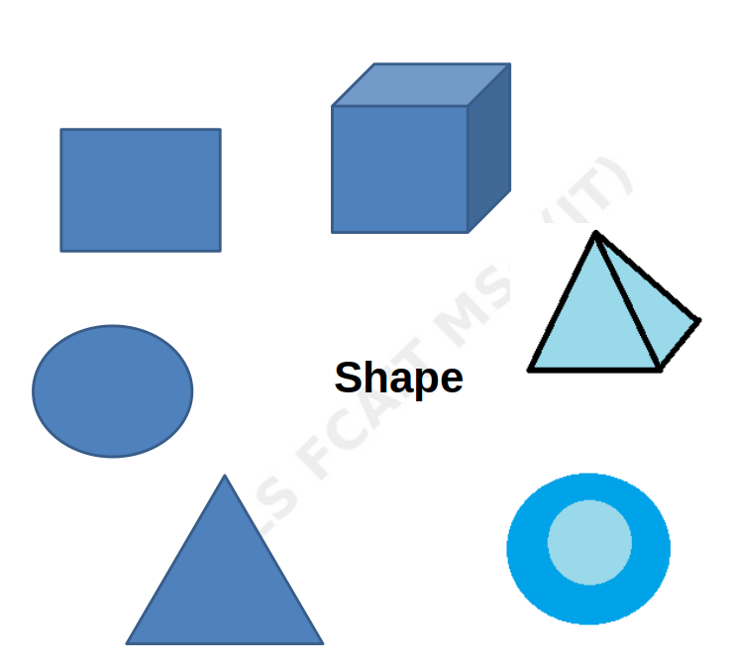
Figure illustrates that the superclass Shape has many subclasses. On examination of these subclasses you can see that there are two distinctly different groups of Shapes : two-dimensional shapes and three-dimensional shapes

Slide 17
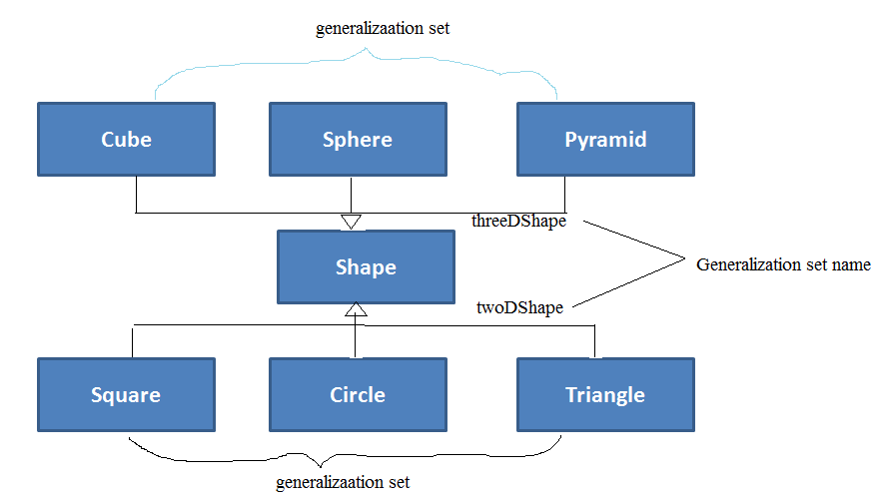
You can indicate this partitioning of subclasses on a class diagram by associating each group of shapes with a different generalization set types

Slide 18
Generalization sets can have constraints applied to them
Constraints:
1. {complete}
The parent class is fully divided into its subclasses.
Example:
TrafficLight can only be Red, Yellow, or Green.
No object exists directly as TrafficLight, only as one of the subclasses.
2. {incomplete}
The parent class can exist on its own OR may have other unspecified subclasses in the future.
Example:
Vehicle may have subclasses Car, Bike, but there could still be Vehicle objects without being classified into any subclass.
Complete | Incomplete
Every superclass instance belongs to at least one subclass | Some superclass instances may belong to none
All possibilities covered | Not all possibilities covered
Closed classification | Open classification

Slide 19
3. {disjoint}:
An object can belong to only one subclass at a time.
Example:
1. Employee can be either FullTimeEmployee OR PartTimeEmployee, not both.
2. 2D shapes not belong to 3D shapes
4. {overlapping}
An object can belong to multiple subclasses at the same time.
Example:
Person can be a Student AND an Employee at the same time.
Disjoint | Overlapping
Instance can belong to only one subclass | Instance can belong to multiple subclasses
Exclusive classification | Multiple classification allowed
Example: Vehicle → Car/Bus/Truck | Example: Person → Student/Employee

Slide 20
Powertypes
A powertype is a classifier (class) whose instances are the subclasses of another classifier.
In other words:
We have a generalization set (a set of subclasses).
The powertype is a class that represents the types in that generalization set.
Normal class → has objects as instances.
Powertype → has subclasses as instances.

Slide 21
Powertypes
A generalization set is connected to its powertype using a dashed line.
Written as <<powertype>>.
The powertype class sits beside or above the generalization set.

Slide 22
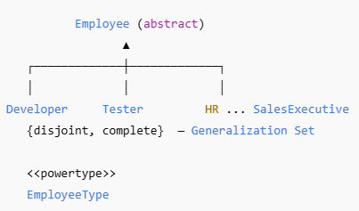

Slide 23
Generalization Set vs Powertype
Feature | Generalization Set | Powertype
Main purpose | Group generalization relationships | Represent subclasses/types as instances
Focus | Classification rules | Types of types
Specifies | Disjoint/overlapping and complete/incomplete constraints | A classifier whose instances correspond to subclasses
Example | Vehicle → Car, Bus, Truck | VehicleType → Car, Bus, Truck
Concerned with | How subclasses relate to superclass | Representing the subclasses themselves

Slide 24
THANK YOU

